Slide 1
Constructing Multicolumn Layouts - Boilerplates, Resets and CSS Frameworks
IN712 Web 3

Slide 2
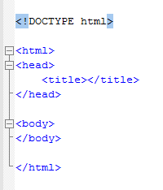
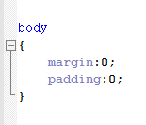
How Many Times Have You Typed This?
HTML boilerplate
CSS reset
These are collections of useful HTML (boilerplate) and CSS (reset) snippets that you can use to get a quick start, or to solve a common problem, in client-side web development.

Slide 3
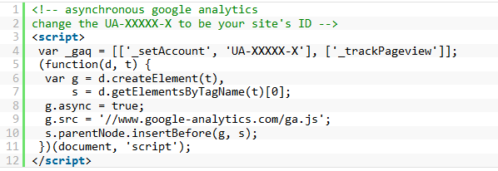
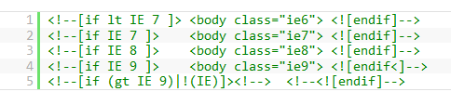
Boilerplates
HTML5 Boilerplate
“Boilerplate” is generic text that can be used over and over
Boilerplates contain chunk of HTML that you can plug and play
There are many of these, but the most commonly used/popular one is HTML5 Boilerplate. The name isn’t quite accurate, as it also contains CSS resets (Eric Meyer’s, in fact) and some JS stuff, but there’s lots of HTML bits
Thoughts? Again, many people point out that if you just copy all these files into your project you get a bunch of stuff you don’t need and you bloat your project size.
So if you’re going to use them, you should actually *just select out the parts that you need*
https://html5boilerplate.com/

Slide 4
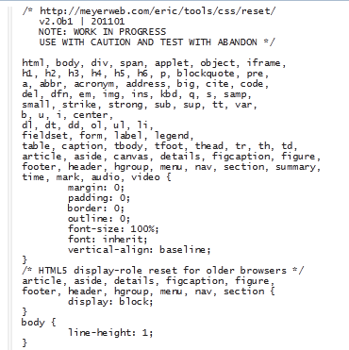
CSS Resets – Good or bad?
There are tons of these, but the most common/popular is this one.
Reset CSS (Eric Meyer’s Reset)
http://meyerweb.com/eric/tools/css/reset/
There are others, some longer
Basically what it does is turn off all the browser-dependent defaults, so your CSS starts with a “blank screen”
Thoughts?
Good? : Saves you from having to reinvent this particular wheel over and over…
Bad?: Bloats code and burdens the browser by applying styles you don’t really actually need
www.cssreset.com

Slide 5
Constructing Multicolumn Layouts

Slide 6
Constructing multicolumn layouts
2 different ways to move items out of the normal top-down flow in HTML using CSS are:
Using positioning
Using floats
A typical layout may very well use both positioning and floats
There is unfortunately no simple and easy way to create robust multicolumn page layouts
There are trade-offs with each approach

Slide 7
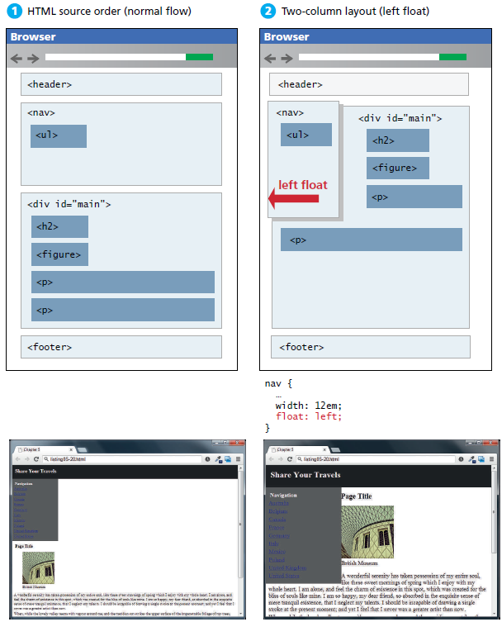
Using floats to create columns

Slide 8
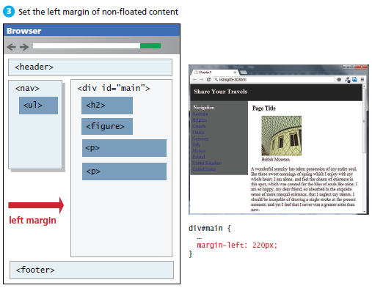
Using floats to create columns

Slide 9
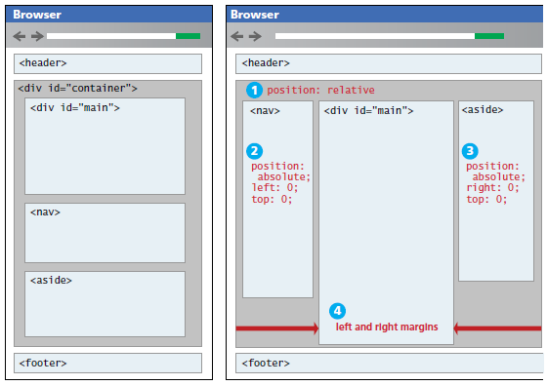
Using positioning to create columns

Slide 10
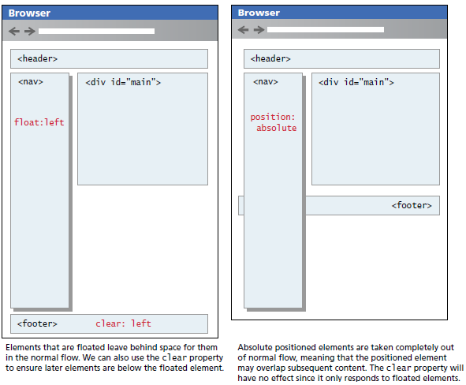
Using positioning to create columns

Slide 11
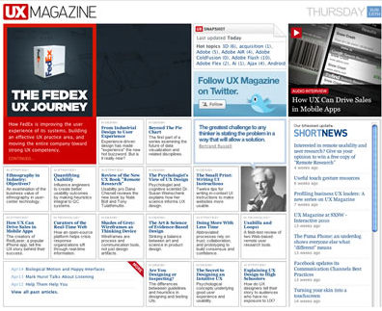
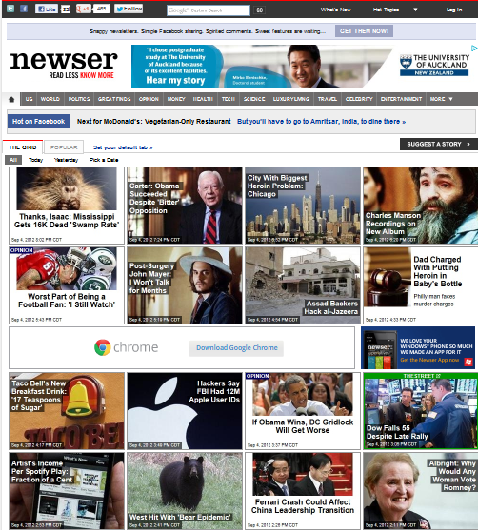

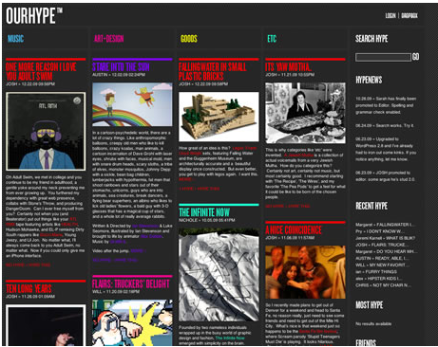
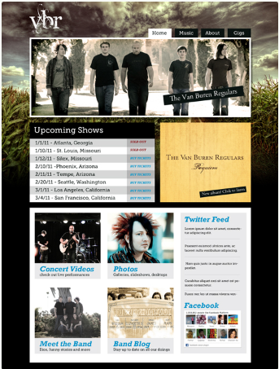
CSS Frameworks

Slide 12
CSS frameworks
CSS Frameworks are collections of useful styles, and these can actually save you a lot of work
So A CSS framework is a precreated set of CSS classes or other software tools that make it easier to use and work with CSS.
For example, a common sort of framework is the grid system
Artistic considerations aside, most web pages used some kind of column, row layout. There are lots of colspans and rowspans, but everything is pretty much lined up
Making columnar layouts used to be done with tables, but that was too rigid (or something) so everyone switched to doing it with CSS
Laying out in columns with CSS is a continuing nightmare of floating and clearing and tweaking pixels of margin and padding, and is basically awful
Some of the new CSS3 options do make this easier, but they’re still fussy
So somebody said “let’s write this stuff up once and use it over and over…”
And that’s a grid system

Slide 13
Grid systems
Grid systems make it easier to create multicolumn layouts. There are many CSS grid systems; some of the most popular are:
Bootstrap (twitter.github.com/bootstrap)
Blueprint (www.blueprintcss.org)
960 (960.gs)
Most provide somewhat similar capabilities. The most important of these capabilities is a grid system
Print designers typically use grids as a way to achieve visual uniformity in a design.
In print design, the very first thing a designer may do is to construct, for instance, a 5- or 7- or 12-column grid in a page layout program
CSS frameworks provide similar grid features.
The 960 framework uses either a 12- or 16-column grid
Bootstrap uses a 12-column grid.
Blueprint uses a 24-column grid.

Slide 14
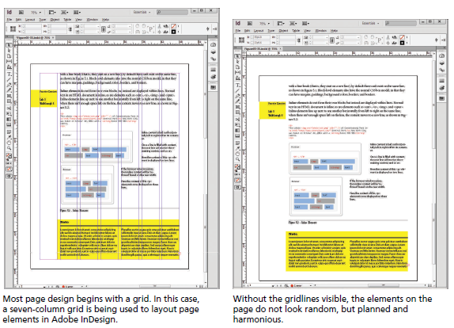
Using a grid in print design

Slide 15
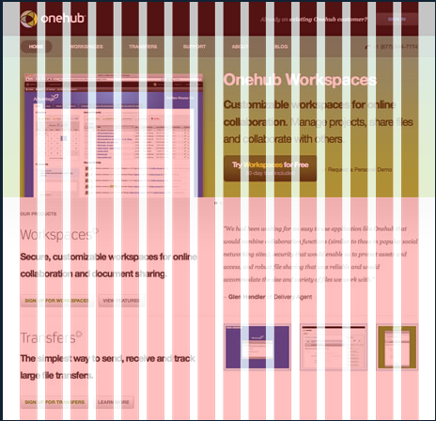
CSS Grid Systems
960 Grid System (URL: 960.gs)
Makes layouts 960 pixels wide
Automates set up of columns
There are (again) lots of these, but this is common/popular and stable.
960 is a good width for 1024x768 screens, allowing for margins and other schmutz.
Lots of professional designers just start everything with a width:960px wrapper div.
What 960 lets you do is automatically get that area divided up into 12 or 16 skinny columns that you then recombine as required to get the layout you want.

Slide 16
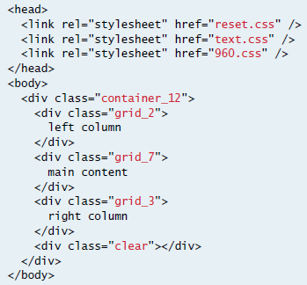
Using the 960 grid

Slide 17
960 Grid System
The 960 Grid System is an effort to streamline web development workflow by providing commonly used dimensions
Based on a width of 960 pixels.
There are two variants: 12 and 16 columns
can be used separately or in tandem
The 12-column grid is divided into portions that are 60 pixels wide.
The 16-column grid consists of 40 pixel increments.
Each column has 10 pixels of margin on the left and right, which create 20 pixel wide gutters between columns.

Slide 18
Why 960?
All modern monitors support at least 1024 × 768 pixel resolution.
960 is divisible by 2, 3, 4, 5, 6, 8, 10, 12, 15, 16, 20, 24, 30, 32, 40, 48, 60, 64, 80, 96, 120, 160, 192, 240, 320 and 480.
This makes it a highly flexible base number to work with.
Purpose
The premise of the system is ideally suited to rapid prototyping, but it works equally well when integrated into a production environment.

Slide 19
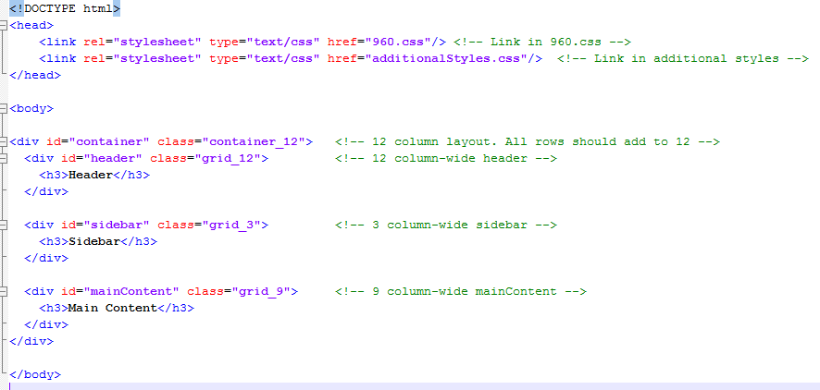
960 Grid System

Slide 20
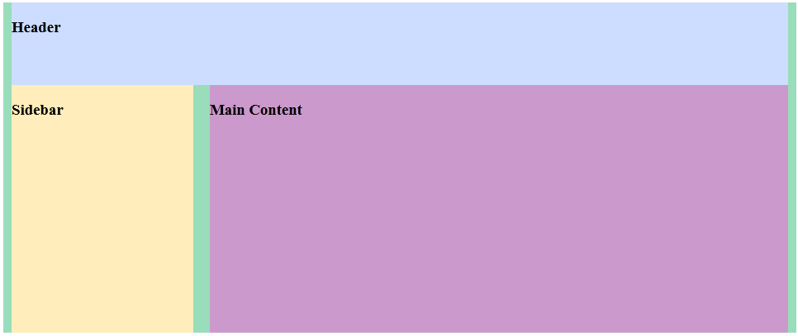
960 Grid System
Magic! No floats, no widths, no nothing…

Slide 21
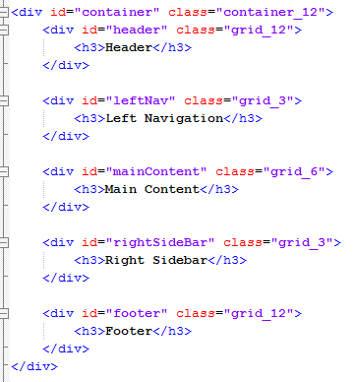
960 Grid System

Slide 22
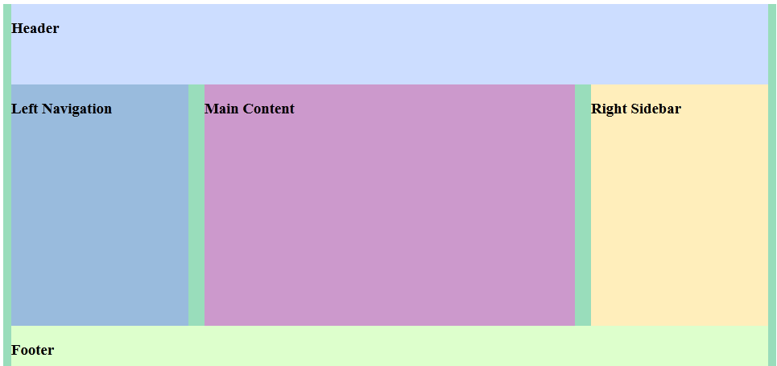
960 Grid System

Slide 23
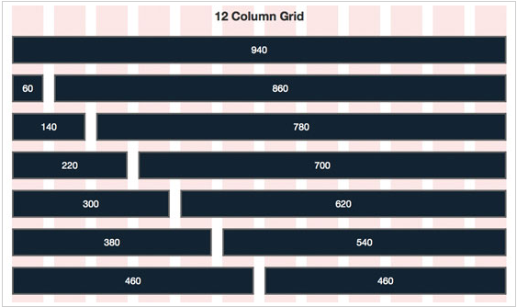
960 Grid System

Slide 24
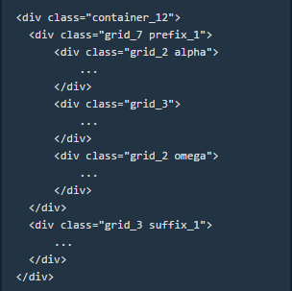
960 Grid System
Classes for fine tuning:
prefix_n: Add n columns of white space before this div
suffix_n: Add n columns of white space after this div
If a grid unit contains grid children:
alpha: This column is the first in the row, set left margin to 0
omega: This column is the last in the row, set right margin to 0

Slide 25
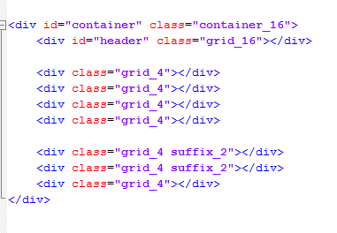
960 Grid System
Here’s a 16 column layout with suffixes
That bottom row uses (4+2) + (4+2) + 4 to get up to 16
If we drop a paragraph of text into each div, it looks like what is shown in the next slide

Slide 26
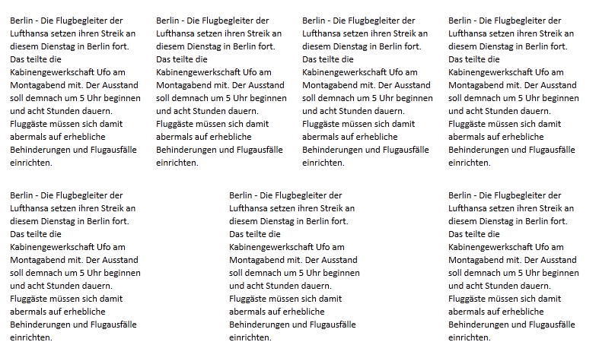
960 Grid System

Slide 27
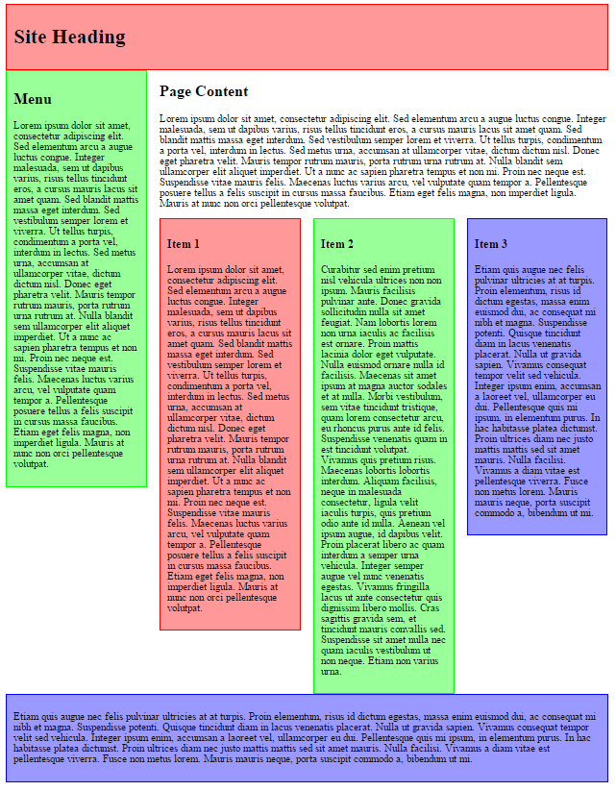
Demo
http://liveweave.com/TEGWgr

Slide 28
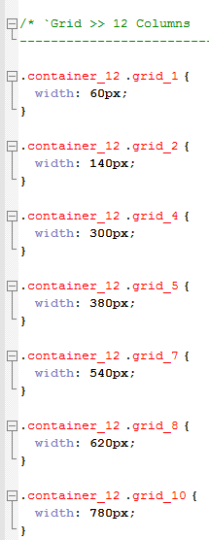
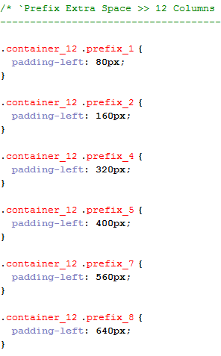
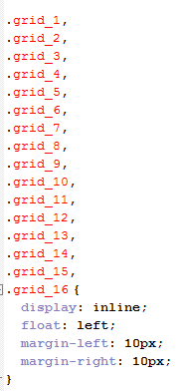
What is in the 960.css file?

Slide 29
Grid Systems
Objections?
Fixed width layout
which means it doesn’t work at tablets/phones etc. A system using percentages rather than pixels would resize gracefully. This won’t
Not semantic
Remember the whole point of separating CSS and HTML was to get format out of the HTML and have all the elements in the HTML be meaningful. It’s pretty hard to argue that “grid_6” is in any way meaningful. So it’s no use to SEO, text readers, other bots, etc.
However, much of this objection can be countered with careful use of additional classes.

Slide 30
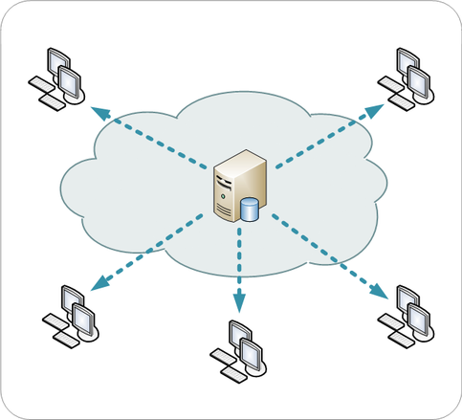
A word about content delivery networks (CDNs)
A content delivery network or content distribution network (CDN) is a globally distributed network of proxy servers deployed in multiple data centers.
The goal of a CDN is to serve content to end-users with high availability and high performance.
CDNs serve a large fraction of the Internet content today, including web objects (text, graphics and scripts), downloadable objects (media files, software, documents), applications (e-commerce, portals), live streaming media, on-demand streaming media, and social networks.

Slide 31

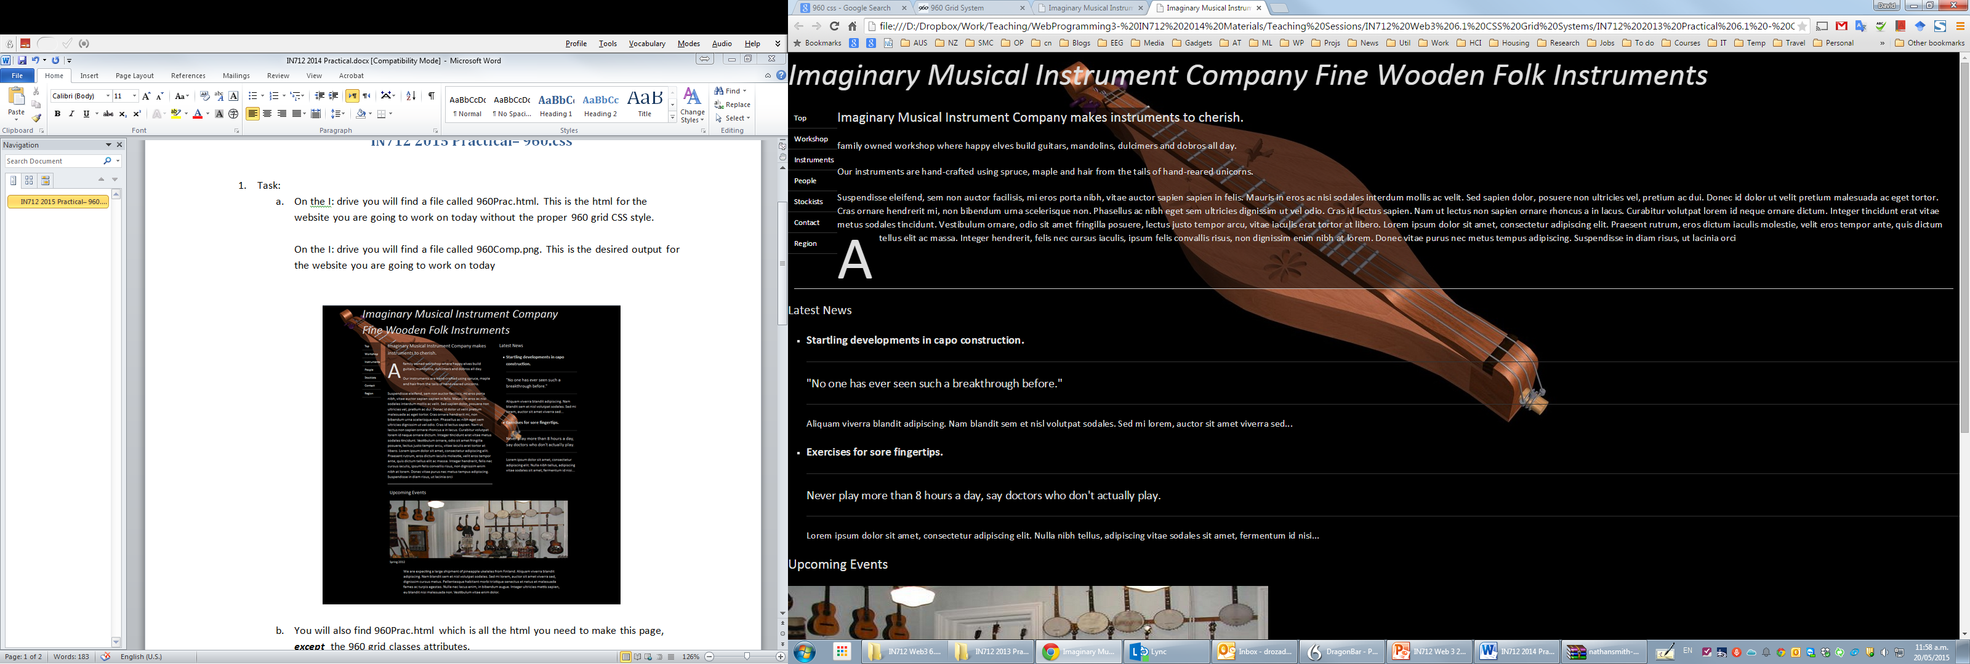
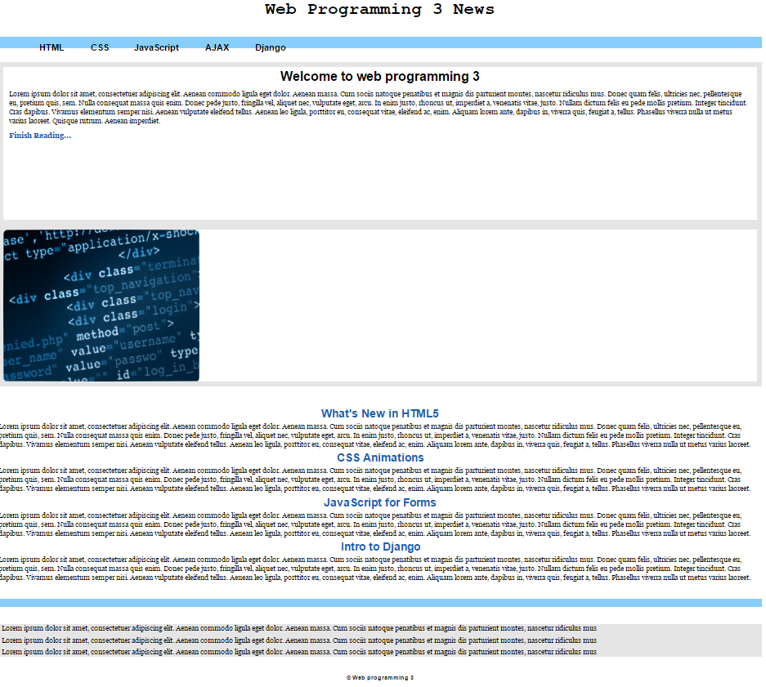
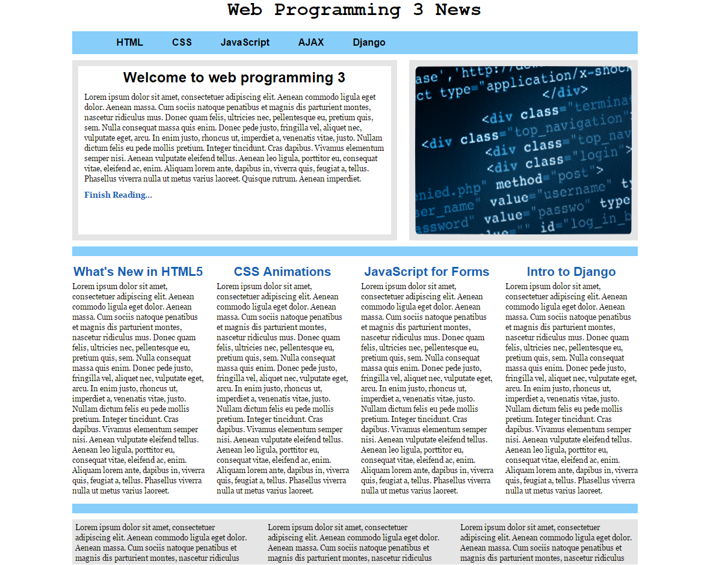
Practical

